Slide 1
Git problems
Solutions to common problems

Slide 2
git basics
init - initialize repository
add - add files to staging area
status - show changes in working directory
commit - save changes to repository
git diff - show changes in between working directory and staging area
git log - show list of previous commits

Slide 3
More git basics
git checkout - restore working directory files
git reset - unstage the file

Slide 4
git for teamwork
remote - a shared repository that resides on an external server
git clone - make a clone of the repository into this repository
git push - push local commits to the remote repository
git fetch - get a preview of the changes in the remote repository
git pull - get the changes from the remote repository

Slide 5
To do for SP
Set up a repository in Github/ Bitbucket / Gitlab
Clone the repository to your local machine
Copy your stuff to the local repository
add git ignore stuff
https://github.com/github/gitignore
commit and push to remote repository
get teammates to clone repository
…
profit!

Slide 6
2 ways of working (actually more)
Centralized workflow
Everyone commits to a single branch
centralized-workflow
Feature workflow
Each feature has its own branch
feature-branch-workflow

Slide 7
You done some work!
commit with sensible message
git pull to get latest work from the rest of the team
conflict?
Resolve conflict
commit conflict resolution
If this work is useful to the rest of the team, push it to the remote repository
Fetch/pull often, at least 2 times a day

Slide 8
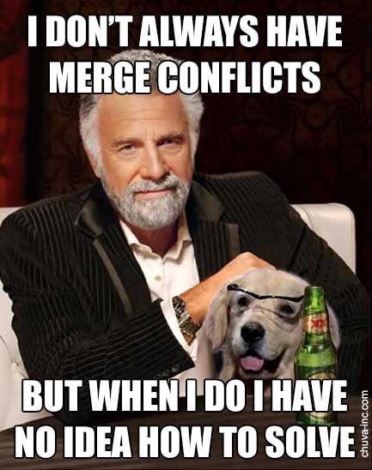
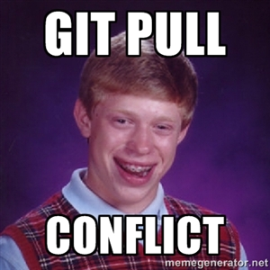
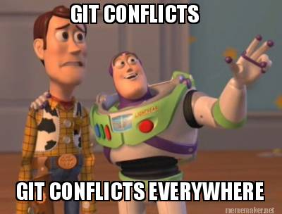

Slide 9
Pro tips
Don’t do mega commits, commit often, commit when you have small wins
Have someone to do code review before commit
Introduce a “fine” for no code review, breaking the build. Then have a party with the money
stash is a good tool to learn
Try not to work on the same file at the same time. Weak tip.
learn your git merge tools https://developer.atlassian.com/blog/2015/12/tips-tools-to-solve-git-conflicts/

Slide 10
Before you pull
Have you committed your work?
Yes
No
can it auto merge or rebase?
Yes
No
Is it done?
Merge manually
Compile and test
Ok?
Commit changes
Pull again
Yes
No
done
Commit it!
Stash it!

Slide 11
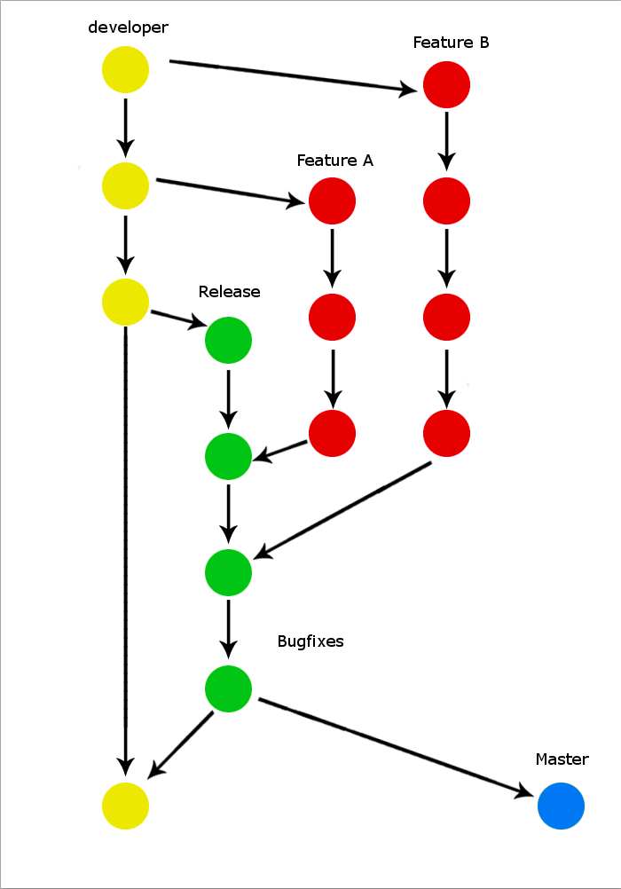
Branching
Branching is a good way of keeping your project sane
Branching helps to keep code clean away from each other.
Merge branches once work is complete.
Merge from main branch to keep up to date.
Merge to main branch to release features
using-branches

Slide 12
merging of old n new versions is a pain in the rear
You might need better tools
You need to read and understand the changes
Get the person who wrote the conflicting code to work with you.
Pull changes more often next time.
Blame the guy who did the mega commit

Slide 13
When your team members commit with some random message that isn't linked to the project. For example, member A commits "Allahu Akbar" and member B commits to reply to member A with "GGEZ"
Troublesome to amend old commit messages
Do code review
https://help.github.com/articles/changing-a-commit-message/

Slide 14
How do we revert back
You should not be reverting back the changes
Do a commit that undo that change
https://git-scm.com/book/en/v2/Git-Basics-Undoing-Things

Slide 15
How to remove weird commit messages like "commit (suicide)"
Prevention is key
Code review helps to prevent stuff like this
Ultimately is your team’s decision

Slide 16
how cherry picking works
Picking specific commits to incorporate into your branch
Hence you need to use branches for this.
Typically you want to pick the good commits from the mistakes
cherry-picking-explained

Slide 17
Member A and B commits and push then member A told everyone to pull. Member B pulled and realises his codes went missing and rage quit.
Before you pull, fetch
stash or commit your change (if it is in the repository, it won’t go missing)
Or don’t pull first, wait till B is done, commit, then pull. Maybe some conflicts.

Slide 18
Member A and B are both working on their portion, and Member A commits. How does Member B get what Member A just pushed, but at the same time retaining his code?
Is it that important to get A’s code like RIGHT NOW??
If it is, you can do a stash, pull, then stash apply

Slide 19
There are a lot of resources out there
https://www.codecademy.com/learn/learn-git
https://www.atlassian.com/git/tutorials/setting-up-a-repository
http://think-like-a-git.net/
https://training.github.com/kit/downloads/github-git-cheat-sheet.pdf
http://ndpsoftware.com/git-cheatsheet.html

